Slide 1
CHANNEL ISLANDS BEACH COMMUNITY SERVICES DISTRICT
Water Supply Alternatives Analysis
November 2016

Slide 2
What Has Been Done
Water Workshop with Board Members (9-20-16)
  Presented system background, issues, etc.
  Administered 50+ question survey and inquired the importance of 7 evaluation criteria
  Board meeting water presentation and board survey results incorporated into Alternatives Analysis Memo
Developed Alternative Analysis and Ranking System
  For each 7 criteria, determine weight (% of final alternative score based on surveyed values)
Developed List of 29 Alternatives
Analyzed Alternatives (10-4-16)
  Assigned scores to alternatives in each evaluation criteria category
Summed Scores and Ranked Alternatives
  Memo “Water Supply Alternatives Analysis” dated 11-4-16
  Developed high level cost estimates for top-ranked alternatives

Slide 3
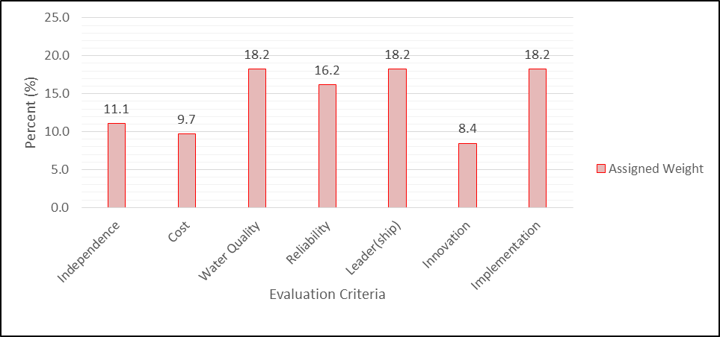
Evaluation Criteria
Water Quality
Leader
Implementation
Reliability
Independence/Control
Cost
Innovation

Slide 4
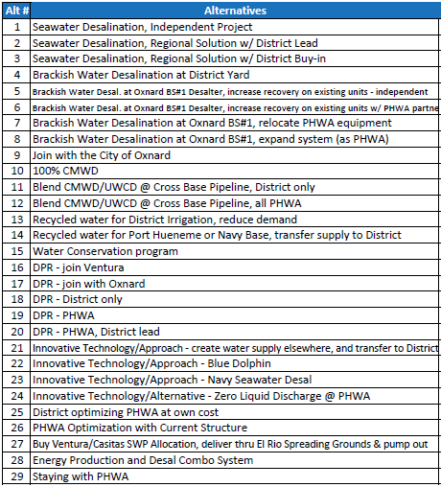
Alternatives Analysis
TOP 5
Brackish Water Desalination at District Yard
Direct Potable Reuse – PHWA, District Lead
Brackish Water Desalination at Oxnard BS#1 Desalter, increase recovery on existing units – District Independent Project
Buy Ventura/Casitas SWP Allocation, deliver through El Rio Spreading Grounds and pump out
Direct Potable Reuse – District Only

Slide 5
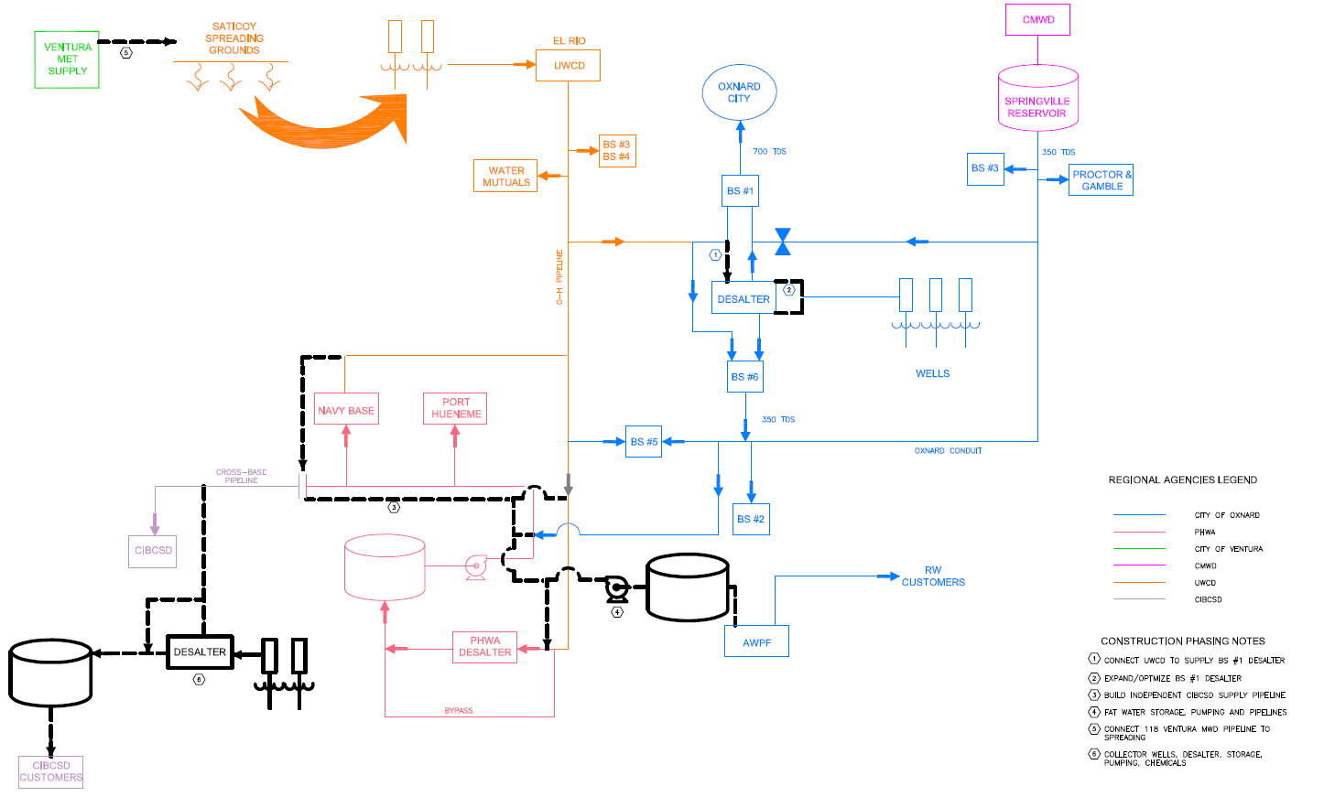
OH WELL FIELD

Slide 6
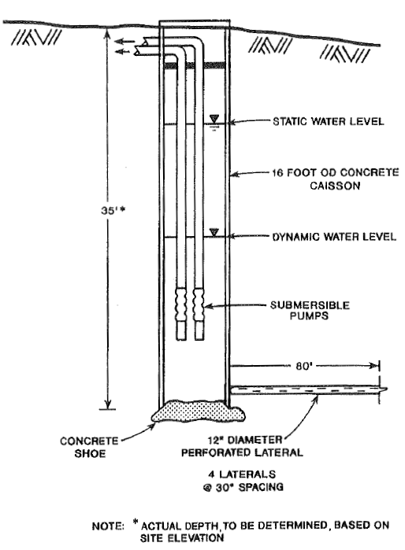
Alt#1 Brackish Water Desalination at District Yard
Seawater will be drawn through subsurface wells. (Feasibility study for Saline GW Intake/Disposal System, Dec. 1992.)
A new RO unit at the District yard will treat the water and store it in a new tank.
A new pipeline will connect the existing OH pipeline to the District’s Cross Base pipeline.
The RO water will be blended with the groundwater and distributed to the District customers.

Slide 7
Alt#1 Brackish Water Desalination at District Yard
OH WELL FIELD
High Quality Stream
Low Quality Stream
Build connection to deliver UWCD supply to District yard.
Combined Stream
Blend UWCD with RO product water.
New storage tank
New RO unit with Brine to Oxnard sewer.
New subsurface seawater supply wells.

Slide 8
Alt#1 Brackish Water Desalination at District Yard

Slide 9
Alt#2 Direct Potable Reuse – PHWA, District Lead
A new 0.5 MG tank would receive advanced treated recycled water from the Oxnard AWPF.
  The water would stay in the tank for 24 hours and then be tested.
  Once quality is confirmed, it would be pumped into the influent of the PHWA BWRDF.
The BWRDF would filter the blended water, as it currently does with influent UWCD.
  The AWPF product water would increase the influent water quality and increase the amount of water that can bypass this system.
No current regulation exists for permitting, although recent reports indicate 5 years based on recently released confirmation of technical feasibility.
May require an air gap.

Slide 10
Alt#2 Direct Potable Reuse – PHWA, District Lead
OH WELL FIELD
High Quality Stream
Low Quality Stream
Combined Stream
Continue normal delivery operation
New storage tank, monitoring eqpt., and pumps.
Blend AWPF product water with BWRDF raw water after 24 hour storage.
Bypass can be increased due to improved raw water quality.

Slide 11
Alt#2 Direct Potable Reuse – PHWA, District Lead

Slide 12
Alt#3 Oxnard BS#1 Desalter Optimization – District Independent Project
The District will pay for the addition of a third stage to the City of Oxnard’s BS#1 Desalter.
  The 2.5 MGD skid will produce an additional 140 AFY with the third stage.
  Two of the three units will be upgraded for a total additional capacity of 240 AFY.
The City will use BS#6 to produce a CMWD equivalent water and deliver to the District via the existing Oxnard Conduit, which is currently used to deliver CMWD supply to PHWA’s BWRDF.
A new pipeline will be constructed to deliver this CMWD equivalent water from the Oxnard Conduit to the Cross Base Pipeline.

Slide 13
Alt#3 Oxnard BS#1 Desalter Optimization – District Independent Project
OH WELL FIELD
Optimize existing BS#1 Desalter. Share additional water with Oxnard.
Deliver all UWCD allocation through BS#1 Desalter and BS#6. Requires new connection @ BS#1.
High Quality Stream
Low Quality Stream
Combined Stream
BS#6 blends CMWD equivalent water.
Connect Oxnard conduit to Cross Base PL

Slide 14
Alt#3 Oxnard BS#1 Desalter Optimization – District Independent Project

Slide 15
Alt#4 Buy Ventura/Casitas SWP Allocation (deliver through El Rio Spreading Grounds and pump out)
Ventura is building a new connection to CMWD so that existing MWD allocation can be delivered to Ventura.
The District will participate in the construction of this pipeline and pay for imported water to be delivered to UWCD’s forebay for spreading and storage.
UWCD will store the water, pump and deliver to PHWA via the OH pipeline.

Slide 16
Alt#4 Buy Ventura/Casitas SWP Allocation
OH WELL FIELD
New Ventura PL delivers additional Met water to UWCD spreading grounds.
New supply is provided with normal OH deliveries.
High Quality Stream
Low Quality Stream
Combined Stream
Normal operation.

Slide 17
Alt#4 Buy Ventura/Casitas SWP Allocation

Slide 18
Alt#5 Direct Potable Reuse – District Only
A new 0.25 MG tank would receive advanced treated recycled water from the Oxnard AWPF.
  The water would stay in the tank for 24 hours and then be tested.
  Once quality is confirmed, it would be pumped into the influent of the PHWA BWRDF.
  Additional treatment will be required.
A new pipeline would be required to connect the new source and the Cross Base Pipeline.
No current regulation exists for permitting although recent reports indicate 5 years based on recently released confirmation of technical feasibility.

Slide 19
Alt#5 Direct Potable Reuse – District Only
OH WELL FIELD
Blend new supply with UWCD using new OH connection.
High Quality Stream
Low Quality Stream
Connect AWPF supply to Cross Base PL.
Combined Stream
Deliver high quality blended water to District.
New storage tank, monitoring equipment, and pumps.
Additional treatment required. Assume UV.

Slide 20
Alt#5 Direct Potable Reuse – District Only

Slide 21
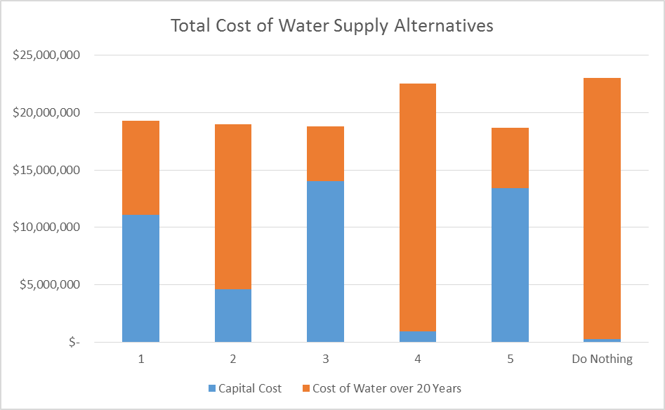
Costs Comparison

Slide 22
Next Steps
Step 1 – Q4 2016
  Distill the discussion on Goals and Values into evaluation criteria (assign weights) *COMPLETE* 9/16
  Apply the evaluation criteria to the Potential Solutions *COMPLETE* 10/16
Step 2 – Q1 2017
  Prepare presentation on Top 5 and overview of process *COMPLETE* 10/16
Step 3 – Q2 2017
  Shortlist to Top 3 during Workshop #2 (11-10-16)
  Board to provide direction to further evaluation of Top 3

